Slide 1
Java BufferedOutputStream class
The BufferedOutputStream class provides buffering to your output streams. Buffering can speed up IO quite a bit. Rather than write one byte at a time to the network or disk, you write a larger block at a time. This is typically much faster, especially for disk access and larger data amounts.
By setting up such an Buffered output stream, an application can write bytes to the underlying output stream without necessarily causing a call to the underlying system for each byte written.
Java BufferedOutputStream class uses an internal buffer to store data. It adds more efficiency than to write data directly into a stream. So, it makes the performance fast.
FileOutputStream
Buffer
BufferedOutputStream
uses
myoutputfile.txt
Java Application
Write
Write

Slide 2
Java BufferedInputStream class
To add buffering to your OutputStream's simply wrap them in a BufferedOutputStream. Here is how that looks:
OutputStream output = new BufferedOutputStream( new FileOutputStream("c:\\data\\myoutputfile.txt"));

Slide 3
Java BufferedInputStream class
You can set the buffer size to use internally by the BufferedOutputStream. You provide the size as a constructor parameter.
This example sets the internal buffer to 8 KB. It is best to use buffer sizes that are multiples of 1024 bytes. That works best with most built-in buffering in hard disks etc.
Except for adding buffering to your input streams, BufferedOutputStream behaves exactly like an OutputStream. The only difference is that you may need to call flush() if you need to be absolutely sure that the data written until now is flushed out of the buffer and onto the network or disk.
int bufferSize = 8 * 1024;
OutputStream output = new BufferedOutputStream( new FileOutputStream("c:\\data\\myoutputfile.txt“, bufferSize );

Slide 4
Java BufferedInputStream class
OutputStream
FilterOutputStream
BufferedOutputStream

Slide 5
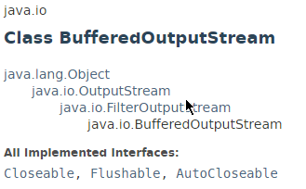
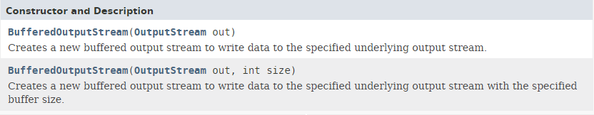
Java BufferedInputStream class

Slide 6
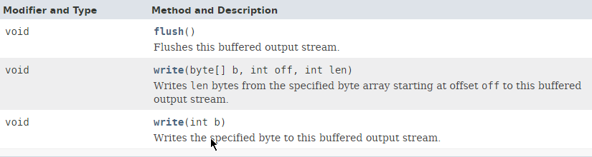
Java BufferedInputStream class

Slide 7
Java BufferedInputStream class
https://docs.oracle.com/javase/8/docs/api/index.html?java/io/BufferedOutputStream.html

